Slide 1
BUSINESS INTELLIGENCE 381 G. Mudare

Slide 2
Connecting to Data Sources
Get data from relational data sources

Slide 3
Get data from relational data sources
You can use Power BI Desktop to establish a connection to your organization's relational database, rather than getting data from individual flat files.
Connecting Power BI to your database will help you to monitor the progress of your business and identify trends
Power BI Desktop can connect to many relational databases that are either in the cloud or on-premises.
Examples include SQL Server, Access, Oracle, IBM Db2, Informix, MySQL, PostgreSQL, Sybase , Teradata, SAP HANA, Amazon Redshift, Impala, Google BigQuery, etc.

Slide 4
Connecting to SQL Server
You will need to have a version of SQL Server already deployed on your machine.
Launch SQL Server Management Studio (SSMS) and connect to your SQL Server instance.
Then, in the Object Explorer, right-click on Databases and select Restore Database.
In our example, we will use a database called “Event Sales”, which you will find in folder called “05-Connecting to SQL Server”
Select the database backup called “EventSales.bak”.
You will need to restore this database into an instance of SQL Server.
Finally, on the left of the Restore Database dialog, select the Files page and activate the checkbox marked Relocate all files to folder.
Click OK to start the restore operation.

Slide 5
Connecting to SQL Server
Let us look at the structure of the database by expanding the Database Diagrams folder and double-clicking the diagram, dbo.Default.
The database contains 11 tables

Slide 6
BI data model
The data model, we have six tables, only five of which have been imported from the original database.
The reduction in the number of tables from database to data model is typical of Power BI workflows.
The most important table in the data model, Dates Table, has been created in Power BI:
Dates Table (Date, Year, Month Num, Month)
Almost all data models in Power BI require a date table containing all the different time related categories by which you want to categorize your data.

Slide 7
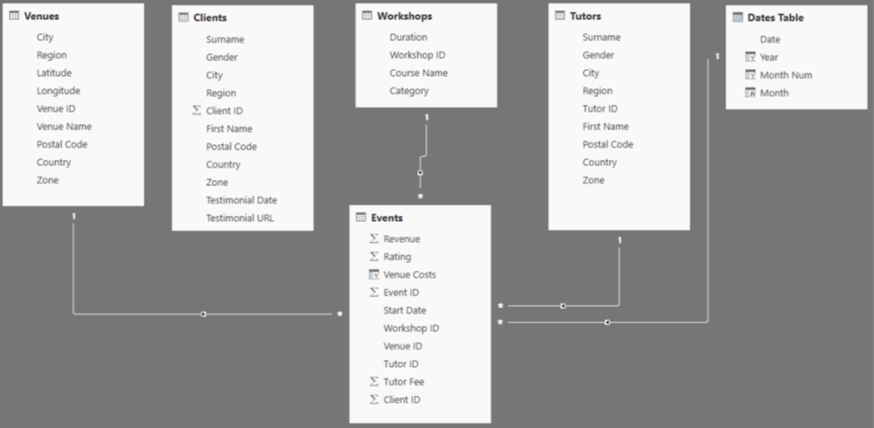
Star Schema
The structure of our data model is referred to as a star schema.
It consists of a single main table, referred to as a fact table; and several supporting tables, all linked to the central fact table, which will be used to categorize the data in the fact table, and which are referred to as dimension tables.
As our focus shifts towards reporting and analysis, we denormalize the relational database and introduce a certain amount of redundancy in order to facilitate data analysis.

Slide 8
Importing SQL Server Views
When importing data from SQL Server, you always need to think ahead to the data model you wish to create and devise a strategy which will facilitate its creation.
In general, the most efficient approach is to avoid connecting directly to the tables in your relational database.
You can create a series of views, each corresponding to one of the tables which will be present in your data model.
In Power BI, you then connect to these views rather than to the original database tables.
Taking this approach makes it easier to update your Power BI data models if modifications are made to the database tables or to the database structure

Slide 9
Create A star Schema
In SQL Server Management Studio’s Object Explorer, expand the Northwind database; then, expand the Views folder.

Slide 10
Importing SQL Server Views
To import data from a SQL Server database, choose
Home > Get Data > SQL Server.
When the SQL Server connection dialog appears, enter the name of your SQL Server instance in the Server field.
You do not need to enter a name in the Database field; since, if the database field is left blank, when you click the OK button, you will be given access to all the databases on the server.

Slide 11
Data Connectivity Mode
The two options in data connectivity mode are:
Import (selected by default, recommended) and
DirectQuery
When you use the DirectQuery option, data is not imported from SQL Server into the data model of your SQL Server report.
Instead, when the report creator configures visuals in Power BI Desktop, the actual data source is always queried, not an imported copy.
Thus, performance of the SQL Server instance will have a big impact on the user experience.
DirectQuery is a useful option when reports require very up-to-date information
It is also a good solution where the dataset is too large to be imported into Power BI.
Set the Data Connectivity mode to Import.

Slide 12
Importing SQL Server Views
Click on the Advanced options button and make sure that that Navigate using Full Hierarchy is checked.
This causes Power BI to display all objects in easily recognizable groups, making it much easier to find stuff.
Click OK.

Slide 13
Authentication Mode
When you connect to SQL Server, you need to specify the authentication mode you wish to use.
There are three options: Windows, Database and Microsoft account.
The default selection, Windows, should be selected.
Click the Connect button to advance to the next screen.
If you receive a message (“We were unable to connect to the data source using an encrypted connection”), click OK to dismiss it

Slide 14
Importing SQL Server Views
In the Navigator window, use the arrows on the left to expand, first, the SQL Server instance, then Northwind > View_name (the name of our view).
Click in the checkboxes next to each of the views to activate them, then click the Load button.

Slide 15
Importing SQL Server Views
Once the data has been loaded into Power BI, click on the Relationships button on the left of the screen, and you will see that Power BI has automatically created relationships between each of the four dimension tables and the main fact table.

Slide 16
Enhancing the Data Model
By creating views in SQL Server, we have kick-started our data modelling; we can now use the three DAX calculation options in the Model tab (measures, calculated columns and calculated tables) to complete the data model.
Let us add Date table to the data model
Switch to data view by clicking on the Data button on the left of your screen
Click on New Table to use a DAX formula to create a dynamic data table. create a date table consisting of a single column of dates starting from the first day of the earliest year in our orders table and ending on the last day of the final year.

Slide 17
Enhancing the Data Model
Enter the following DAX formula:
Dates Table = CALENDAR (
DATE ( YEAR ( MIN ( Orders[OrderDate] ) ), 1, 1 ),
DATE ( YEAR ( MAX (Orders[OrderDate] ) ), 1, 1 )
)
This formula creates a single column table consisting of an uninterrupted series of dates within the specified time frame.
Add further columns to complete the date table; by creating a few key columns.

Slide 18
Enhancing the Data Model
Use the New Column command to add four columns to the table, using the following formulas:
Year = YEAR('Dates Table'[Date])
Quarter = FORMAT('Dates Table'[Date], "Q")
Month Num = MONTH('Dates Table'[Date])
Month = FORMAT('Dates Table'[Date], "MMMM")
When done click Mark as Date Table on the Table context ribbon and choose Date as the date column

Slide 19
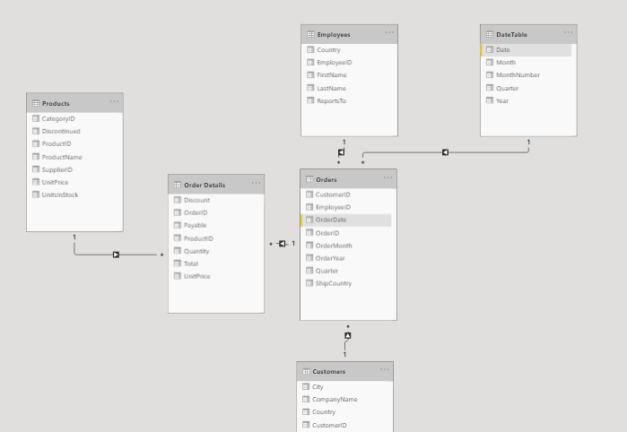
Creating relationships
Click OrderDate on the Orders table and drag it to the Date column in the DateTable to create the relationship

Slide 20
Enhancing the Data Model
Create a relationship between Dates Table and the main Orders table by dragging from Dates Table > Dates to Order > OrdersDate or vice versa.
When creating a relationship in an imported data model (as opposed to a DirectQuery one), you can drag in either direction to define the Many-to-one relationships required in Power BI.

Slide 21
Refreshing Imported SQL Server Data
Having imported data from an on-premises SQL Server database, when you upload your report to the Power BI service, you will need to set up a refresh schedule to ensure that the version in the cloud is up to date.
The mechanism for doing this is an on-premises data gateway.
The on-premises data gateway acts as a bridge or secure channel to transfer the data from on-premises datasets to the on-cloud Power BI service.
The gateway is a free software utility which is installed on a server or computer that is permanently running.
Once the gateway is configured on the local, on premises computer, it will be visible in the Power BI service.
A refresh schedule for the SQL Server data source can then be created.
In a Power BI Pro capacity, you can refresh up to 8 times a day; within a Power BI Premium capacity, up to 48 times a day.

Slide 22
Key points of interest when importing data from SQL Server.
It is more efficient to import data from SQL Server views than directly from database tables.
Each view should create a data-model-ready table, containing only relevant columns, with report-friendly names.
A data model containing imported SQL Server data can be mashed up with data from other sources, as well as with calculated tables.
There are no restrictions on the creation of DAX calculated tables, measures and calculated columns.
When uploaded to the Power BI service, the imported data needs to be updated via an on-premises gateway using a refresh schedule.

Slide 23
Import Versus Direct Query
You can connect to the same SQL Server views as we did when looking at the Import option; but, this time, we will use DirectQuery mode.
But when using DirectQuery on the left of your Power BI desktop screen, only Report and Relationship modes are available;
Data mode is not present when working in DirectQuery mode.
If you switch to Relationship view and you will notice that Power BI has not automatically created relationships, as it did when we imported the data.
In DirectQuery mode, to create a relationship, you must always drag from the many table to the one table in order to create the many-to-one relationship required by Power BI else you get an error message.

Slide 24
Import Versus DirectQuery

Slide 25
Import Versus DirectQuery
After creating your relationships between our tables, if you switch to Report view, and click on the Modelling Tab of the Ribbon, you can see that the Create Table command may be unavailable.
So, you may not be able to add a date table to your data model at times.
When connecting to a SQL Server database in DirectQuery mode, you cannot add tables from any other data sources into the data model; and, additionally, all the tables to which you connect must be in the same SQL Server database.

Slide 26
Refreshing DirectQuery SQL Server Data
When you upload your report to the Power BI service, you will need a way of directly connecting to your SQL Server instance.
The solution is again the on-premises data gateway.
You do not need to create a refresh schedule; Power BI will use the data source credentials to connect to the on-premises SQL Server instance as necessary.

Slide 27
Key points: DirectQuery connection to a SQL Server database
It is still more efficient to import data from SQL Server views than directly from database tables.
All imported tables and views must come from the same database.
A data model containing a DirectQuery connection to SQL Server data cannot be mashed up with data from any other sources.
Calculated tables cannot be added to the data model.
There are severe restrictions on the use of DAX when creating measures and calculated columns. (These options can be overridden in Power BI Desktop’s options settings.)
When a DirectQuery report is uploaded to the Power BI service, a data source must be created to enable Power BI to connect to the database via an on-premises gateway; however, no refresh schedule needs to be created.

Slide 28
Connecting to Database Tables Using SQL Statements
Some time you may want to use SQL statements.
The same statements that you would use to create views in the SQL Server database can be executed from within Power BI.
Write SQL to to join Orders,Cutomers,Products,Employees etc
SELECT Sales.EventsData.EventID 'Event ID' , Sales.EventsClients.ClientID 'Client ID' , Sales.EventsClients.Revenue , Sales.EventsClients.Rating , Sales.EventsData.StartDate 'Start Date' , Sales.EventsData.WorkshopID 'Workshop ID' , Sales.EventsData.VenueID 'Venue ID' , HR.EventsTutors.TutorID 'Tutor ID' , HR.EventsTutors.TutorFee 'Tutor Fee' FROM Sales.EventsClients INNER JOIN Sales.EventsData ON Sales.EventsClients.EventID = Sales.EventsData.EventID INNER JOIN HR.EventsTutors ON ales.EventsData.EventID = HR.EventsTutors.EventID

Slide 29
Connecting to Database Tables Using SQL Statements
Choose Home > Get Data > SQL Server.
When the SQL Server connection dialog appears, enter the name of your SQL Server instance in the Server field;
Enter “EventSales” in the Database field; and set the Data Connectivity mode to Import.
To access the option to execute an SQL statement, click on the Advanced options button; then, paste the text which you copied earlier into the box marked SQL Statement.
The Advanced options section contains three features which may be activated or deactivated via checkboxes; uncheck all three.

Slide 30
Connecting to Database Tables Using SQL Statements
Click the OK to see a preview of the table generated by your query;
Click the Load button to import the data

Slide 31
Leveraging Query Folding
It is a best practice to avoid writing SQL statements directly in Power BI.
Instead, consider writing a query like this in a view.
Query folding is the process whereby some, or all, of the transformations you define in the Query Editor are converted into SQL statements and executed by the database server.
In other words, the Query Editor transformation is converted from the underlying M language into an SQL statement.
This can provide a significant performance boost each time the data source is refreshed.
However, only SQL statements automatically generated by Power BI are permitted; if you execute your own SQL statement; or, if you use a Query Editor transformation which has no SQL equivalent, no further query folding takes place.

Slide 32
Query Folding
To monitor Power BI’s query folding decisions, right-click on a Navigation step and choose View Native Query from the context menu.
Power BI displays the Native Query dialog within which is displayed the SQL statement which will be executed when this step is encountered.

Slide 33
REVISION
Why are data models in Power BI usually modelled as star schemas?
What are the implications of choosing either Import or DirectQuery data connectivity mode?
What are the key points of interest when importing data from SQL Server?
What is query folding?
Create some visuals to analyse the sales for Northwind Traders e.g., by year, country, etc

